Slide 1
INDUSTRIAL TRAINING PRESENTATION
Fortify & Detect: Sophos Firewall Hardening and SOC-Based Threat Detection Pipeline Development
Endpoint telemetry, SIEM correlation, and MITRE ATT&CK-mapped detection engineering
enriched with live threat intelligence — built and validated in an isolated lab environment.
Presented By: Pari Tenguriya Roll No.: [23EACCC040] Branch: B.Tech, Cyber Security College: [Arya College of Engineering ]

Slide 2
INTRODUCTION
Organization Overview
Company | Duration | Training Domain
Rise Tech Software Pvt. Ltd., Jaipur | 45 Days | Sophos Firewall Configuration & Network Security
About the Training
WHY THIS PROJECT
Firewall administration in isolation rarely shows how perimeter security connects to detection and response. This project builds that missing link — a working pipeline from endpoint telemetry through to enriched, MITRE-mapped alerts.
Industrial training focused on Sophos Firewall (SFOS) configuration, network security policy design, and enterprise perimeter administration.
In parallel, this self-directed project was built to connect that firewall training to a complete Security Operations Center workflow — endpoint monitoring, SIEM correlation, and threat intelligence enrichment.
The project was implemented and validated entirely within an isolated virtual lab, independent of any client environment, consistent with the training program's confidentiality requirements.
2

Slide 3
PROBLEM STATEMENT & OBJECTIVE
Why This Project, and What It Set Out to Do
PROBLEM STATEMENT
OBJECTIVES
A SIEM alone tells you something happened — it does not tell you whether it is likely malicious.
Without threat intelligence context, every alert looks equally urgent, and analysts spend time triaging noise instead of real threats.
Endpoint telemetry (Sysmon) generates high-volume, low-context events unless mapped to a structured framework like MITRE ATT&CK.
Firewall/perimeter administration, endpoint monitoring, and threat intelligence are frequently taught and operated as separate silos.
Deploy a Wazuh SIEM to centrally correlate endpoint telemetry from Windows and Linux hosts.
Configure Sysmon and Auditd for high-fidelity process, network, and authentication event capture.
Author detection rules mapped explicitly to MITRE ATT&CK technique IDs.
Integrate MISP for automated IOC enrichment against live abuse.ch threat feeds.
Validate every detection through controlled adversarial simulation, not assumption.
Threat Intelligence Driven SOC
3

Slide 4
TOOLS & TECHNOLOGIES
Stack Used in This Implementation
Tool | Role in This Project
VMware Workstation | Virtualization platform for the isolated lab
Windows 11 | Monitored endpoint (Sysmon + Wazuh agent)
Ubuntu Server | Wazuh Manager and MISP host
Kali Linux | Controlled attack simulation
Sysmon | Windows process / network / registry telemetry
Wazuh SIEM | Log correlation, detection rules, alerting, dashboard
MISP | Threat intelligence platform — IOC enrichment
MITRE ATT&CK | Technique mapping framework for every detection
Host-only Network | Isolated 192.168.56.0/24 lab segment
NOTE
Sophos Firewall is intentionally not listed here — it is covered separately under Future Work, since perimeter integration was designed but not yet deployed against a live device within this project's scope.
Threat Intelligence Driven SOC
4

Slide 5
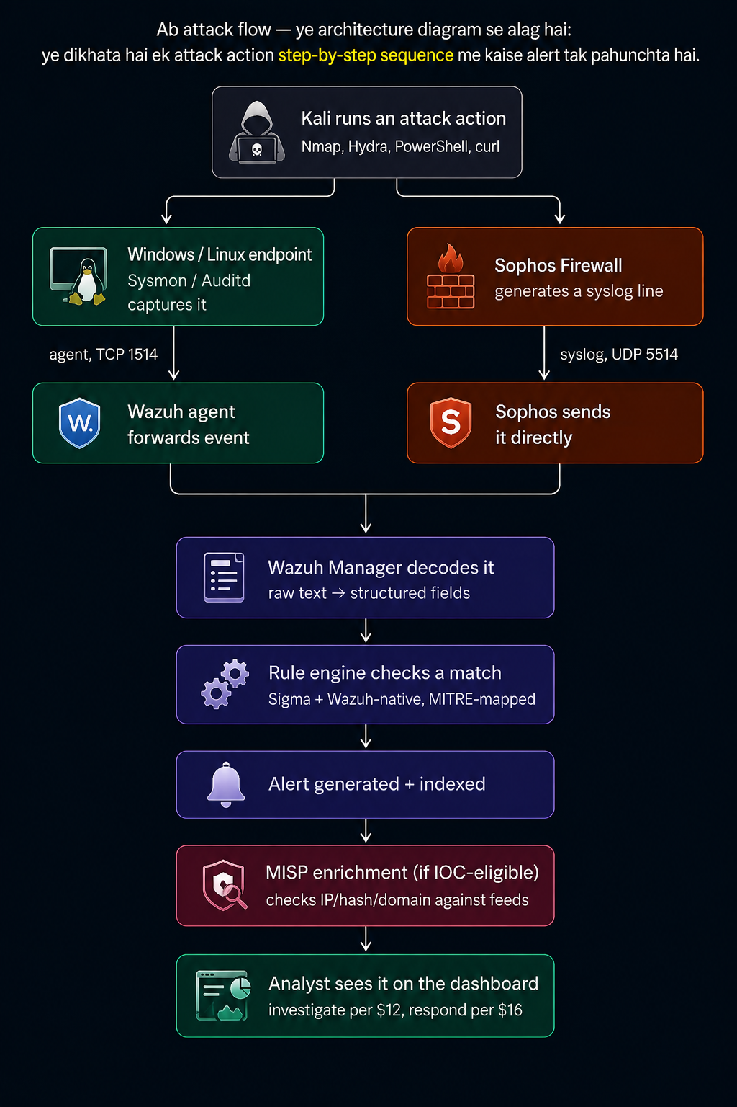
METHODOLOGY / WORK PROCESS
Attack-to-Alert Flow
The project follows a detect → decode → correlate → enrich → investigate workflow. An attack action from Kali is captured at the endpoint, forwarded to Wazuh, matched against MITRE-mapped rules, optionally enriched via MISP, and surfaced to the analyst dashboard.
Kali generates a controlled attack action (Nmap, Hydra, PowerShell reverse shell).
Sysmon / Auditd captures the resulting event at the endpoint.
The Wazuh agent forwards it over TCP 1514 to the Wazuh Manager.
The rule engine matches it against a Sigma / Wazuh-native, MITRE-mapped rule.
If the alert is IOC-eligible, Wazuh queries MISP over REST for enrichment.
The analyst investigates the enriched alert on the dashboard.
Threat Intelligence Driven SOC
5

Slide 6
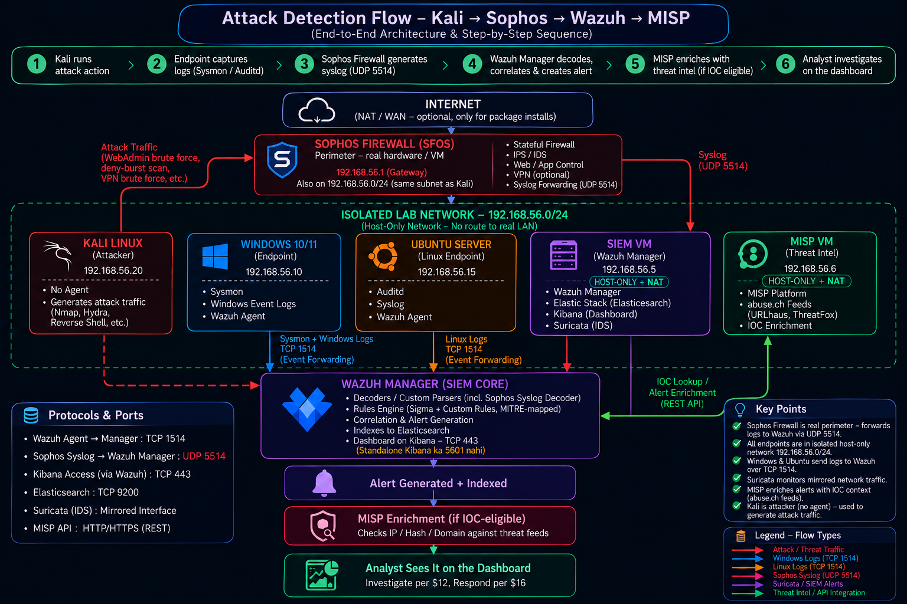
SYSTEM ARCHITECTURE
Full Pipeline: Endpoint → SIEM → Threat Intel
T
6

Slide 7
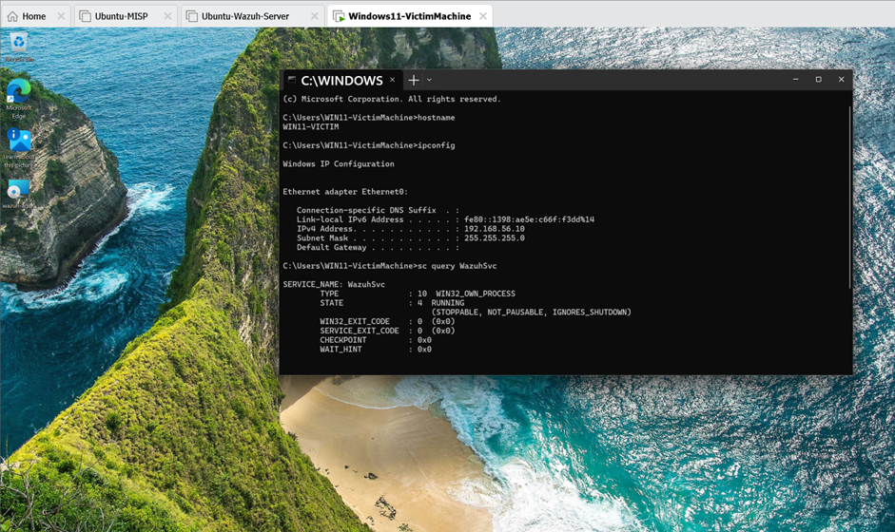
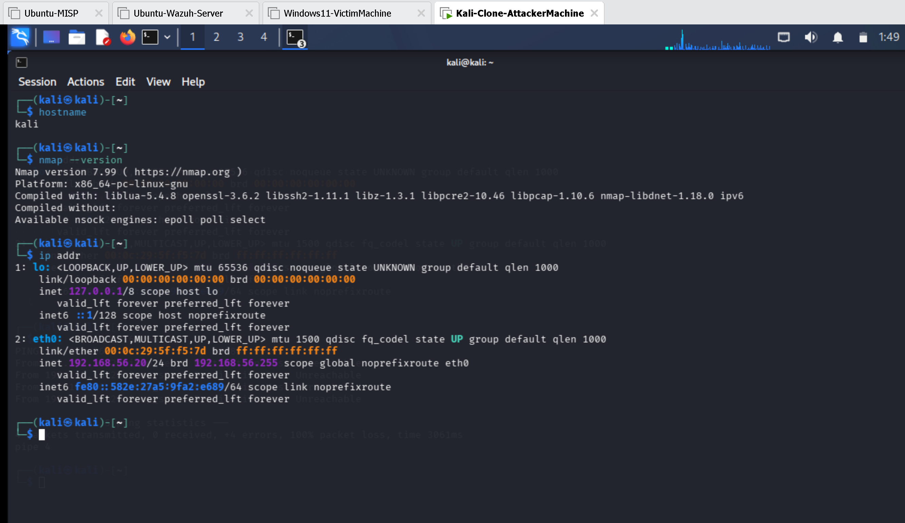
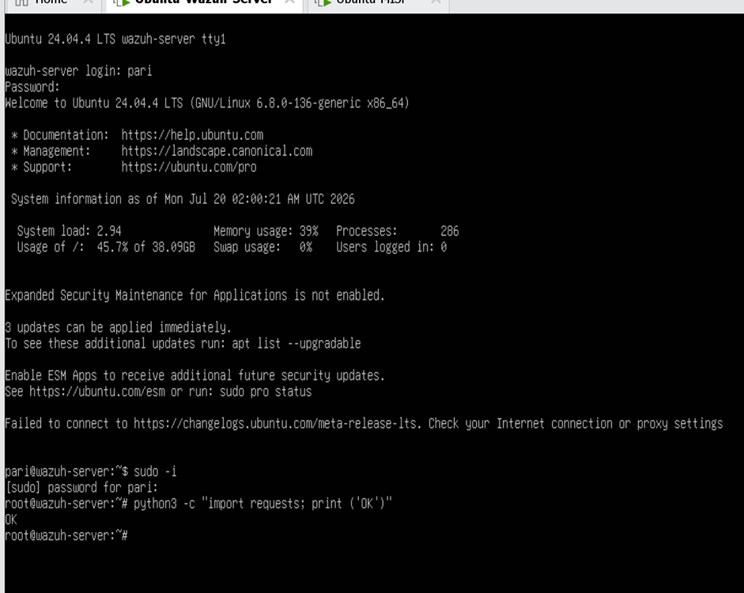
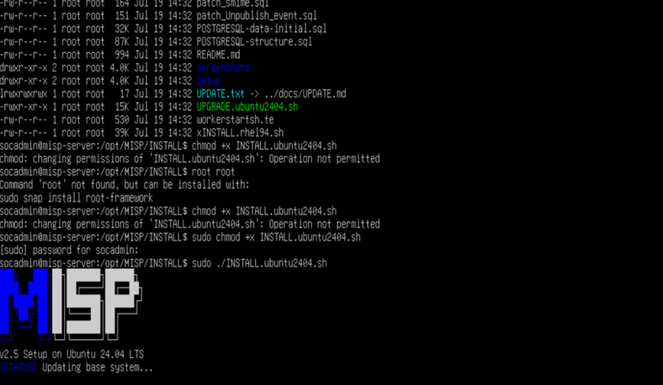
Virtual Machine Used
Windows –victim machine
Kali-attacker
Ubuntu-wazuh-server

Slide 8
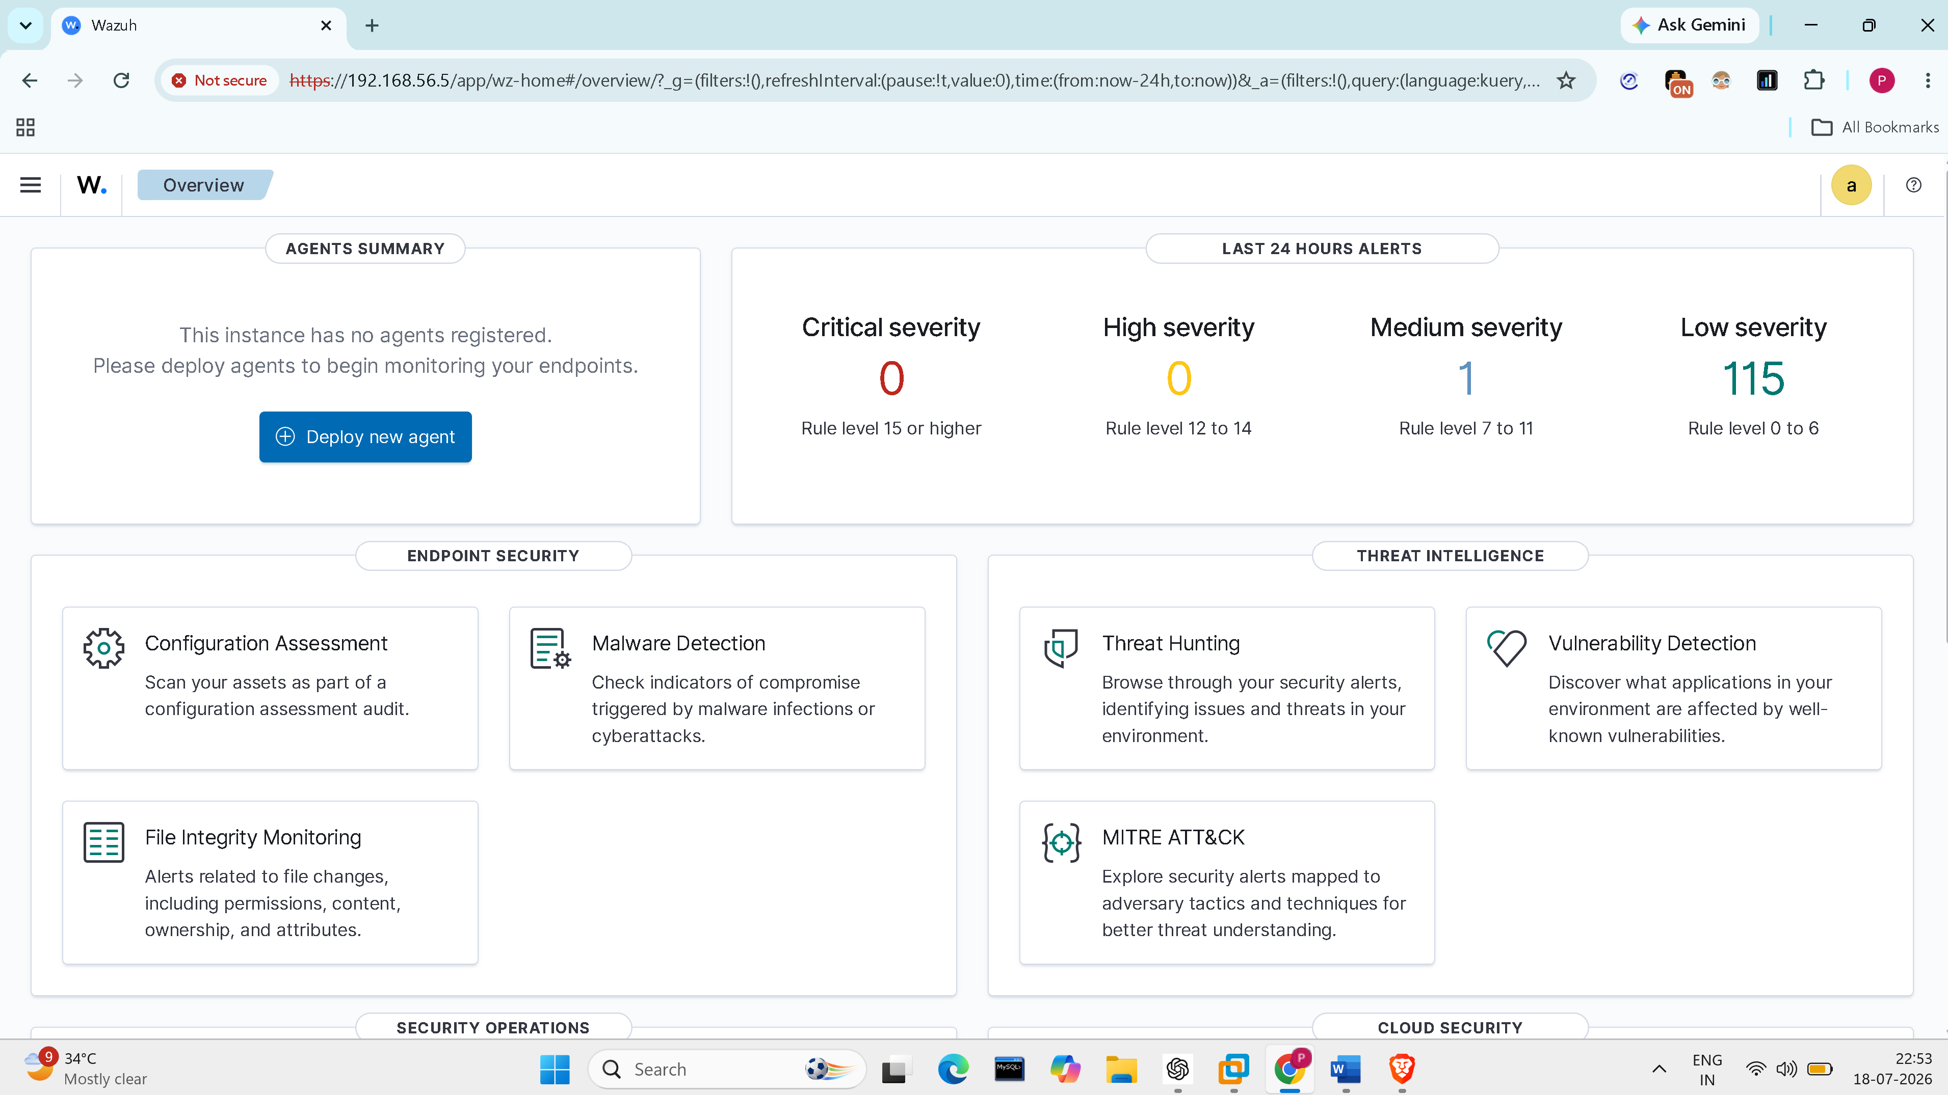
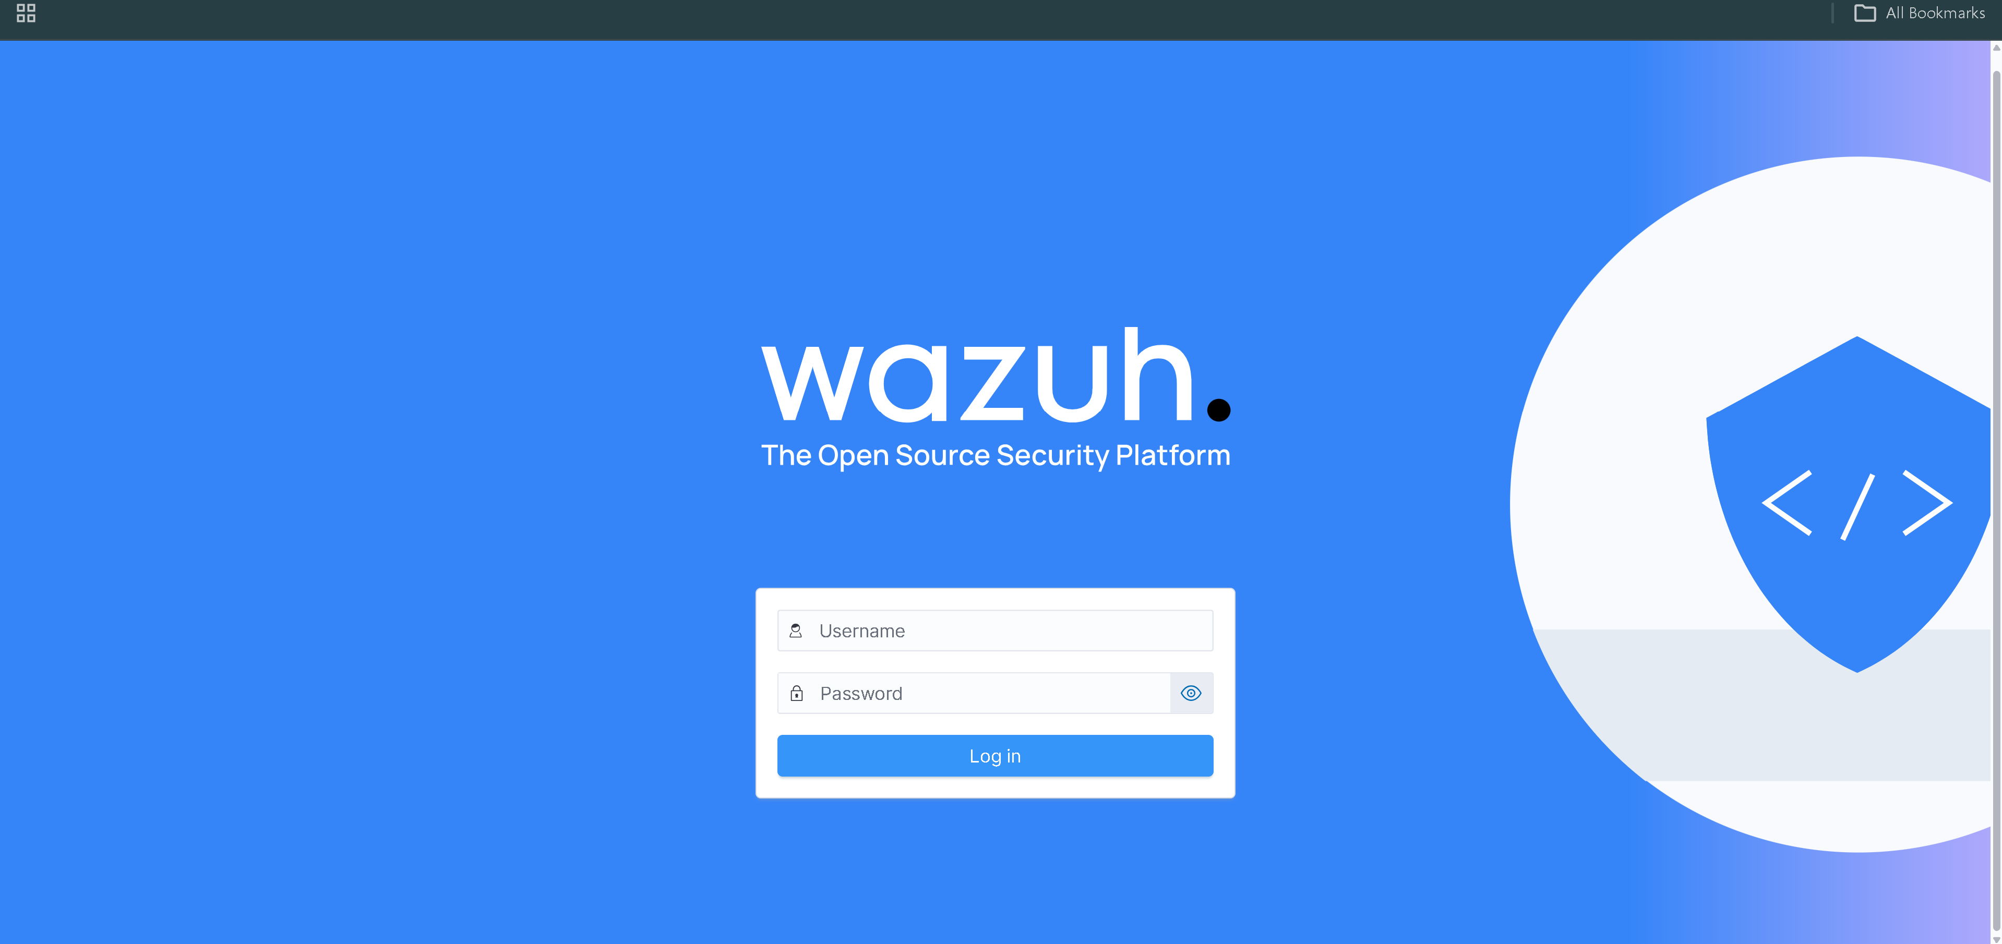
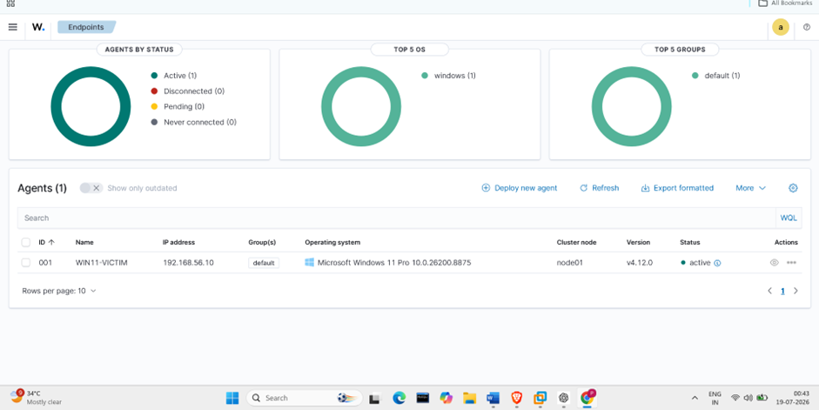
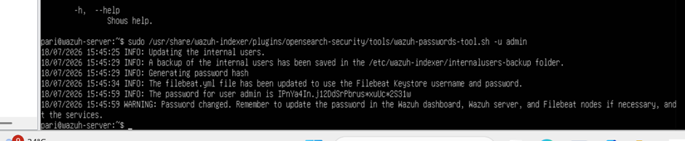
Wazuh console Login and Dashboard
Login Credentials Provision
Dashboard before agent
Log in page
Dash board after agent integration

Slide 9
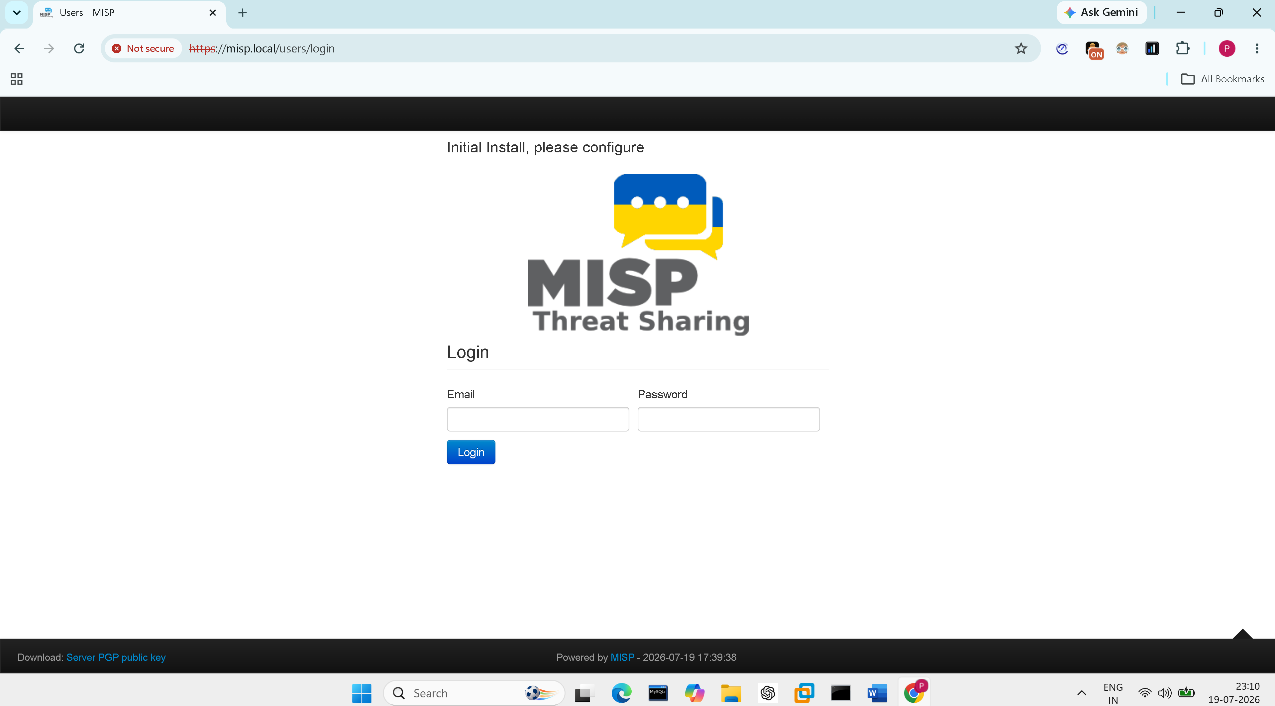
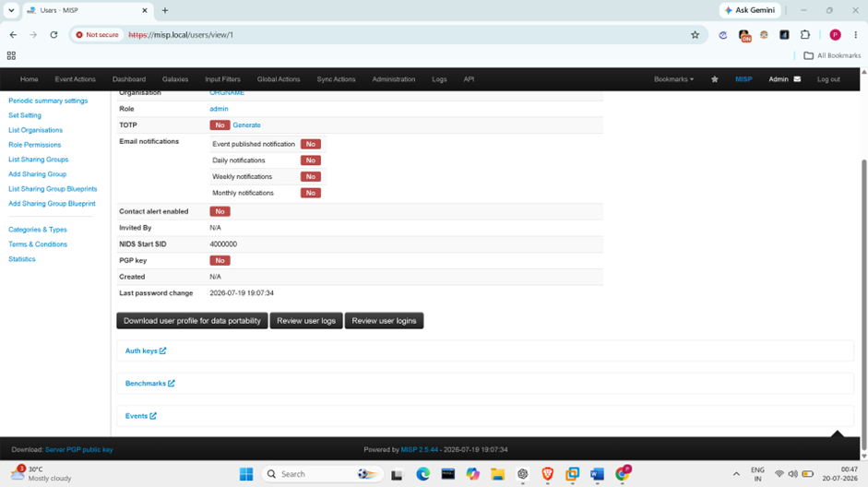
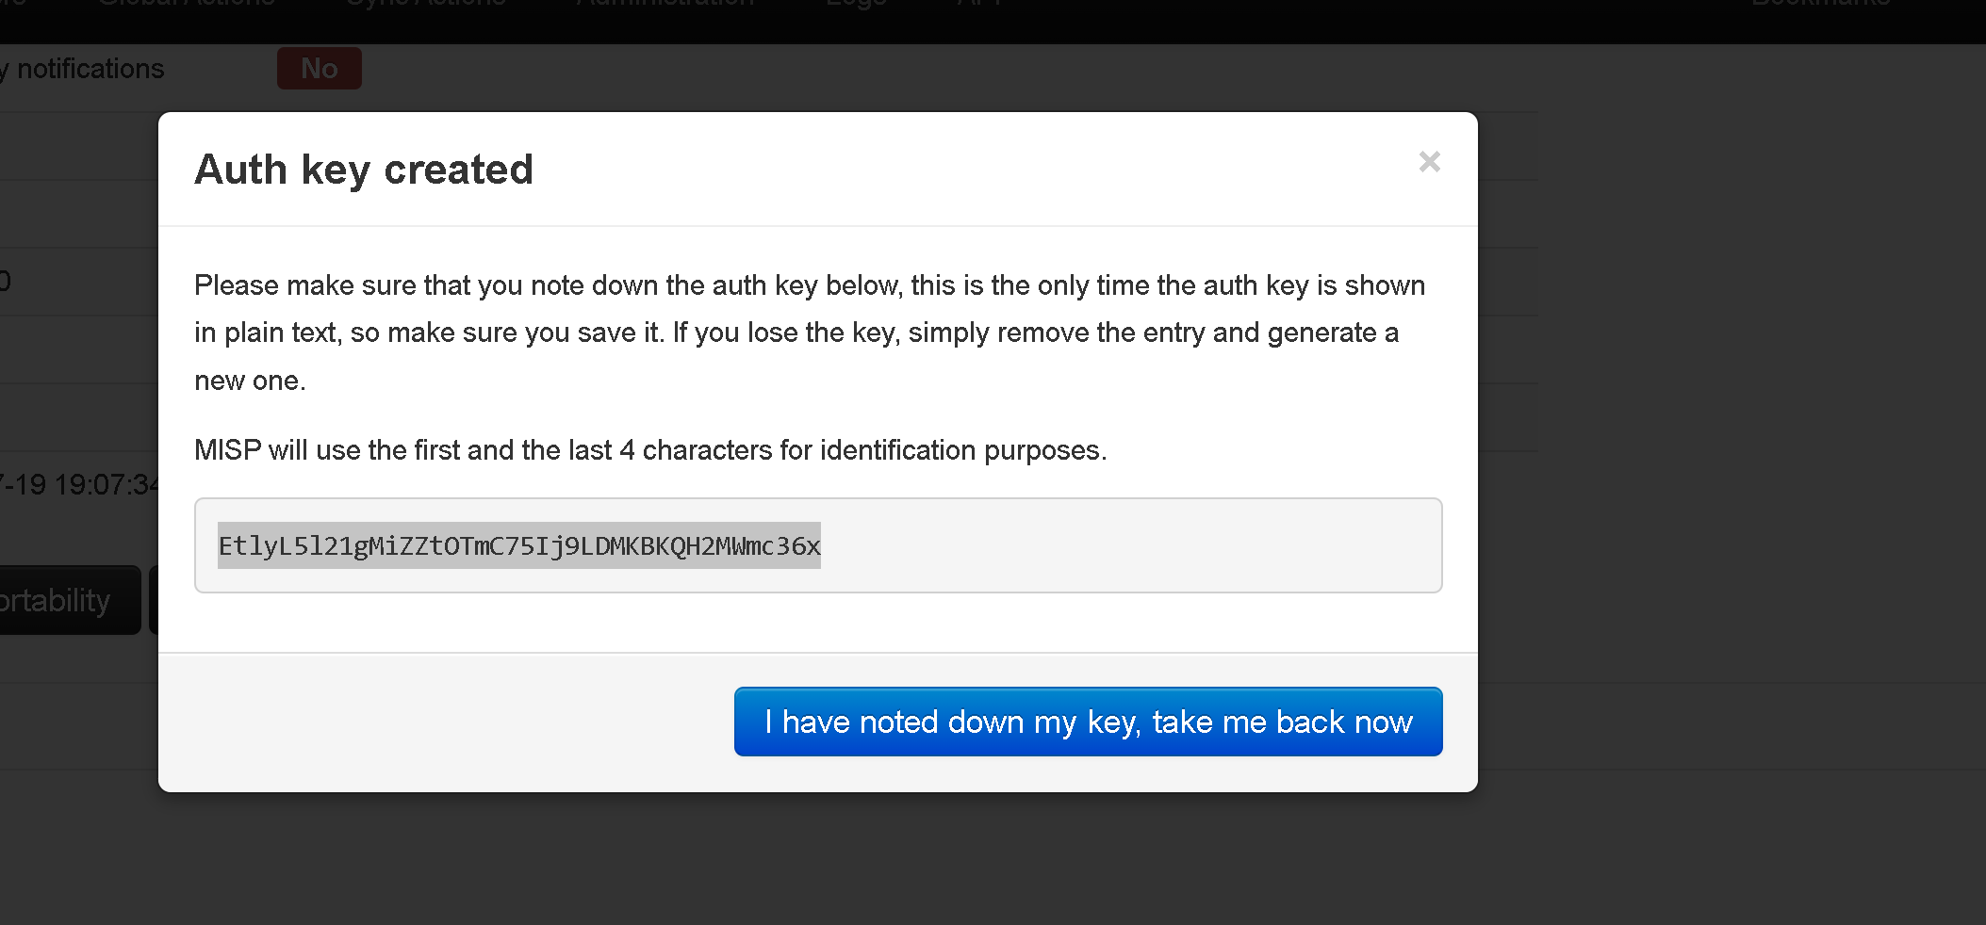
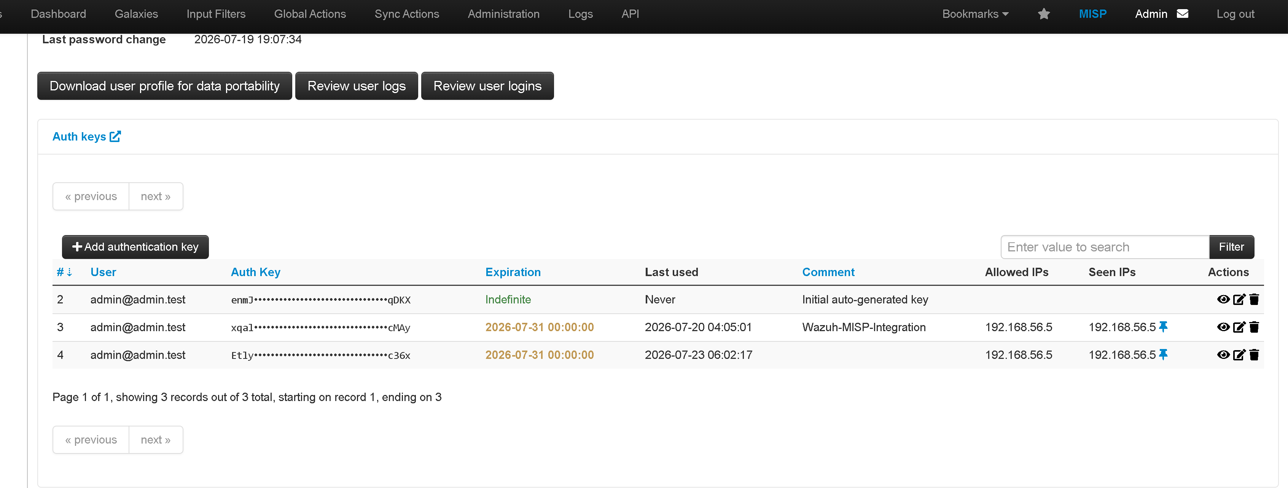
MISP Dashboard and Rest Authorization KEY GENERATION-

Slide 10
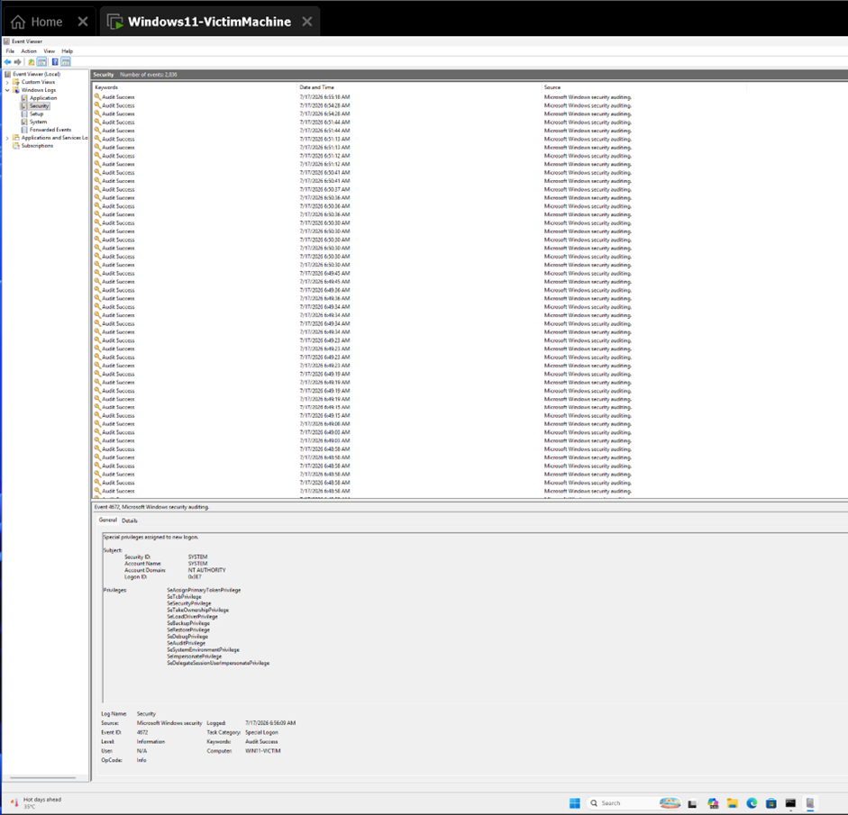
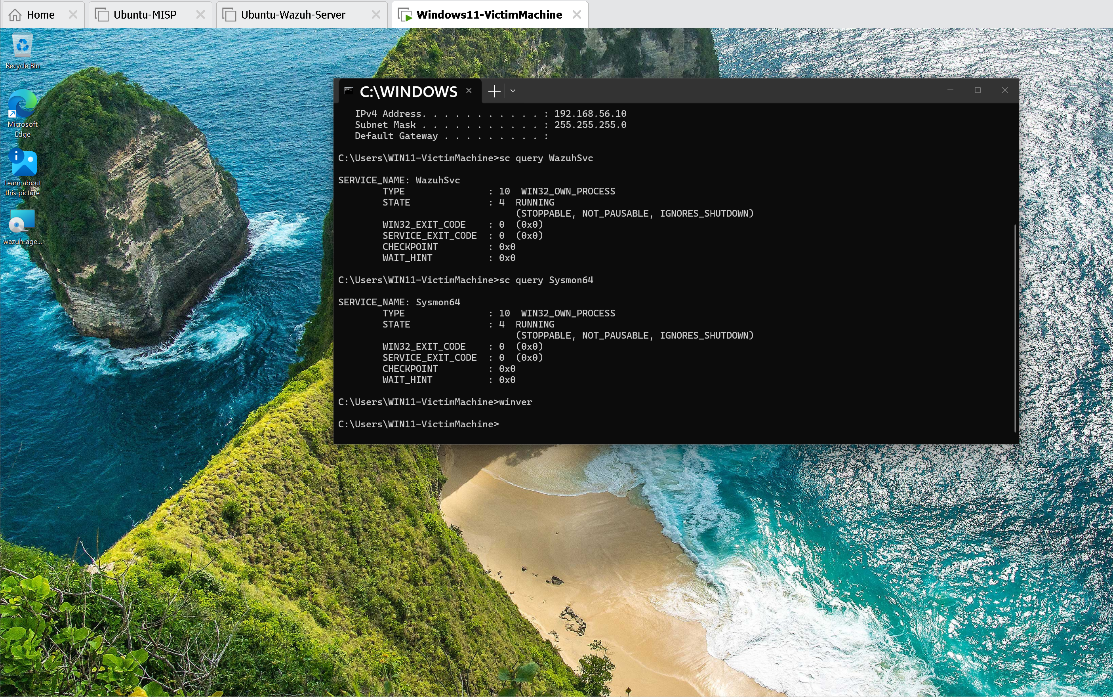
Windows – Sysmon Communication and Log generation
Appropriate Security Log Generation
Sysmon in Running state in Win-Victim machine

Slide 11
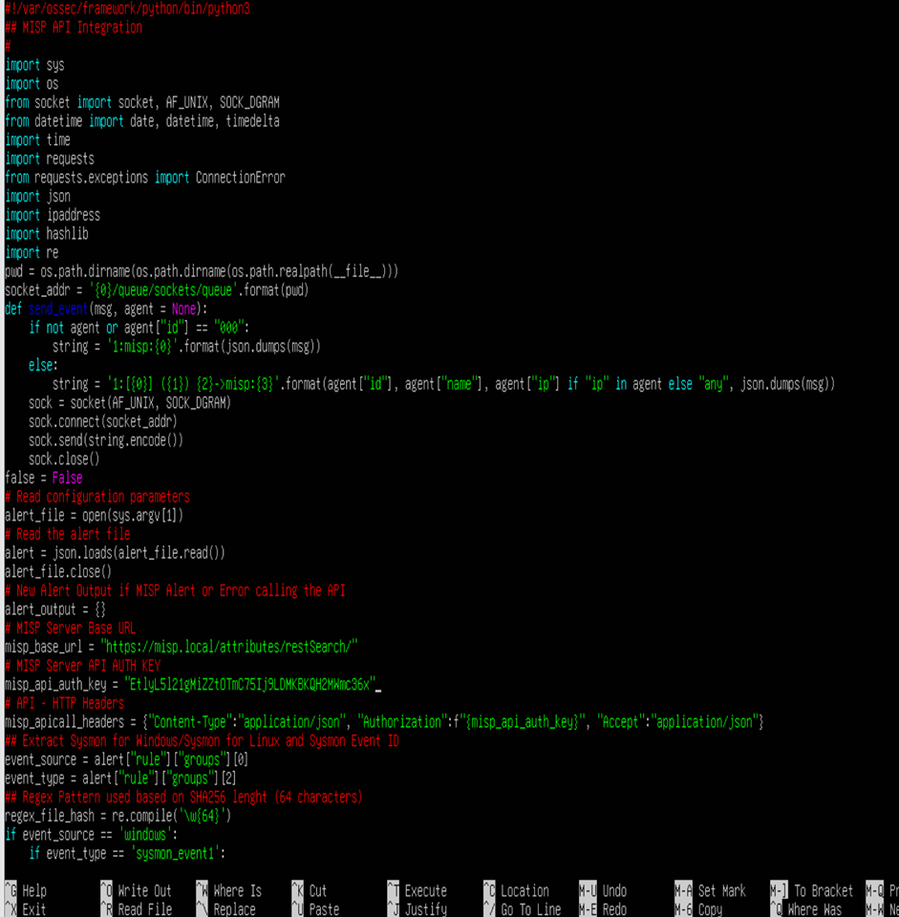
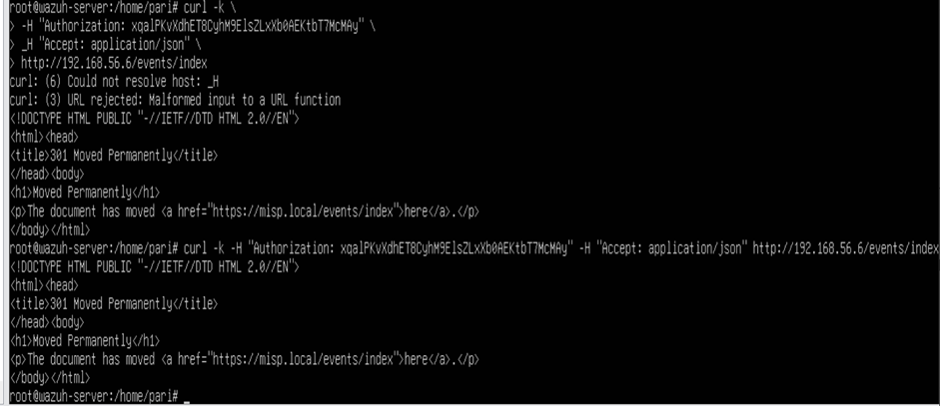
WAZUH – MISP INTEGRATION
 | root@wazuh-server:/home/pari# curl -k \ > -H "Authorization: EtlyL5l21gMiZZt0TmC75Ij9LDMKQH2MWmc36x" \ > -H "Accept: application/json" \ > http://192.168.56.6/events/index <!DOCTYPE HTML PUBLIC "-//IETF//DTD HTML 2.0//EN"> <html><head> <title>301 Moved Permanently</title> </head><body> <h1>Moved Permanently</h1> <p>The document has moved <a href="https://misp.local/events/index">here</a>.</p> </body></html> root@wazuh-server:/home/pari#

Slide 12
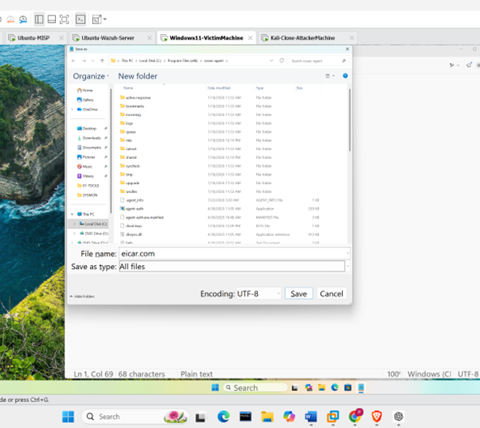
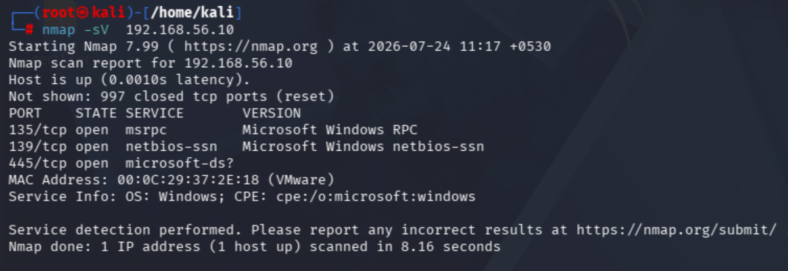
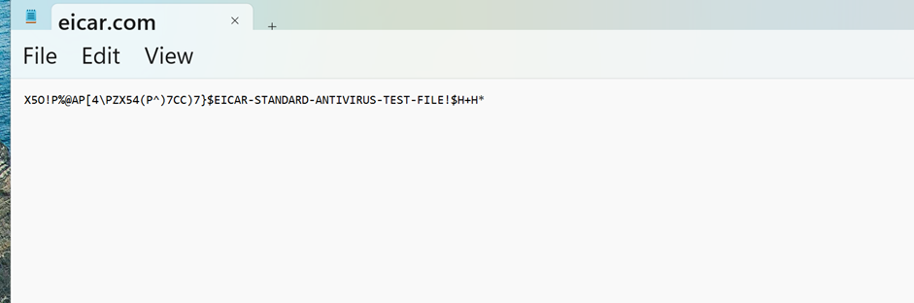
ATTACK SIMULATION — EVIDENCE
Simulated Attacks (Insert Your Screenshots)
▣
▣
▣
Insert screenshot here
Insert screenshot here
Nmap Port Scan
EICAR FILE
Reverse Shell Callback
Threat Intelligence Driven SOC
11

Slide 13
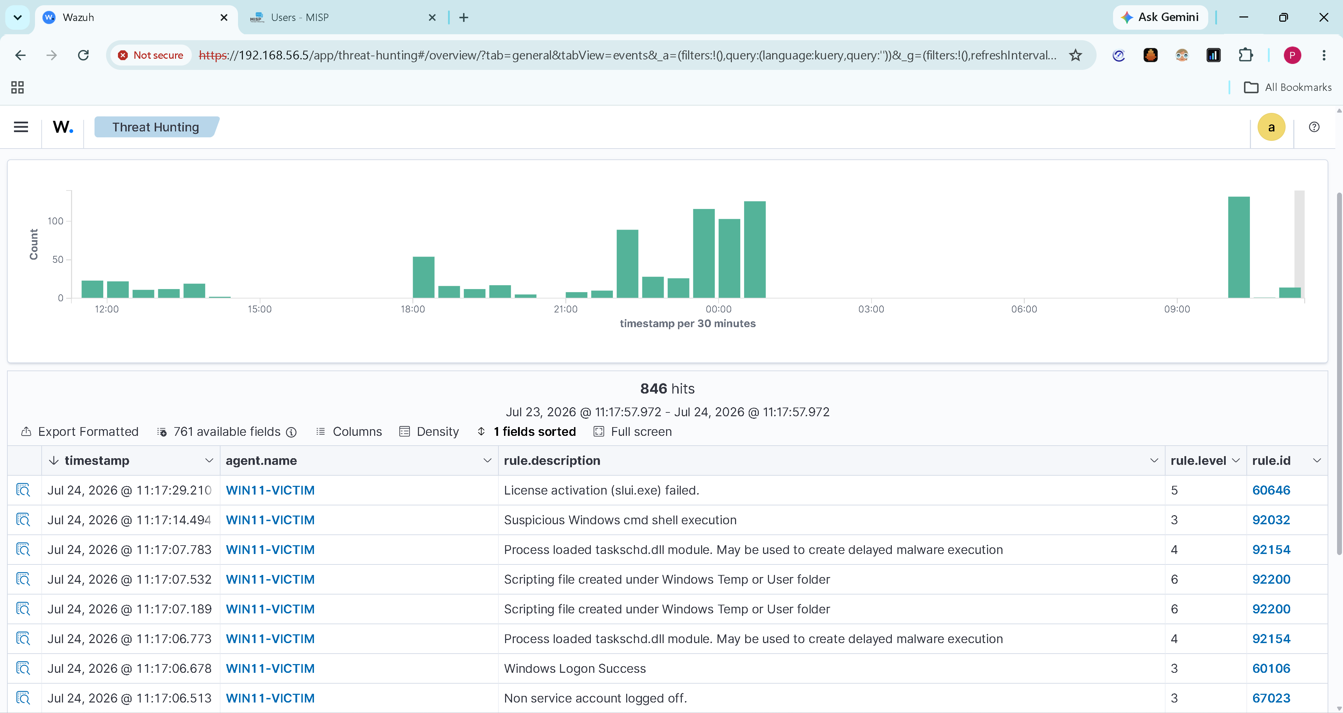
Threat Intelligence Monitoring

Slide 14
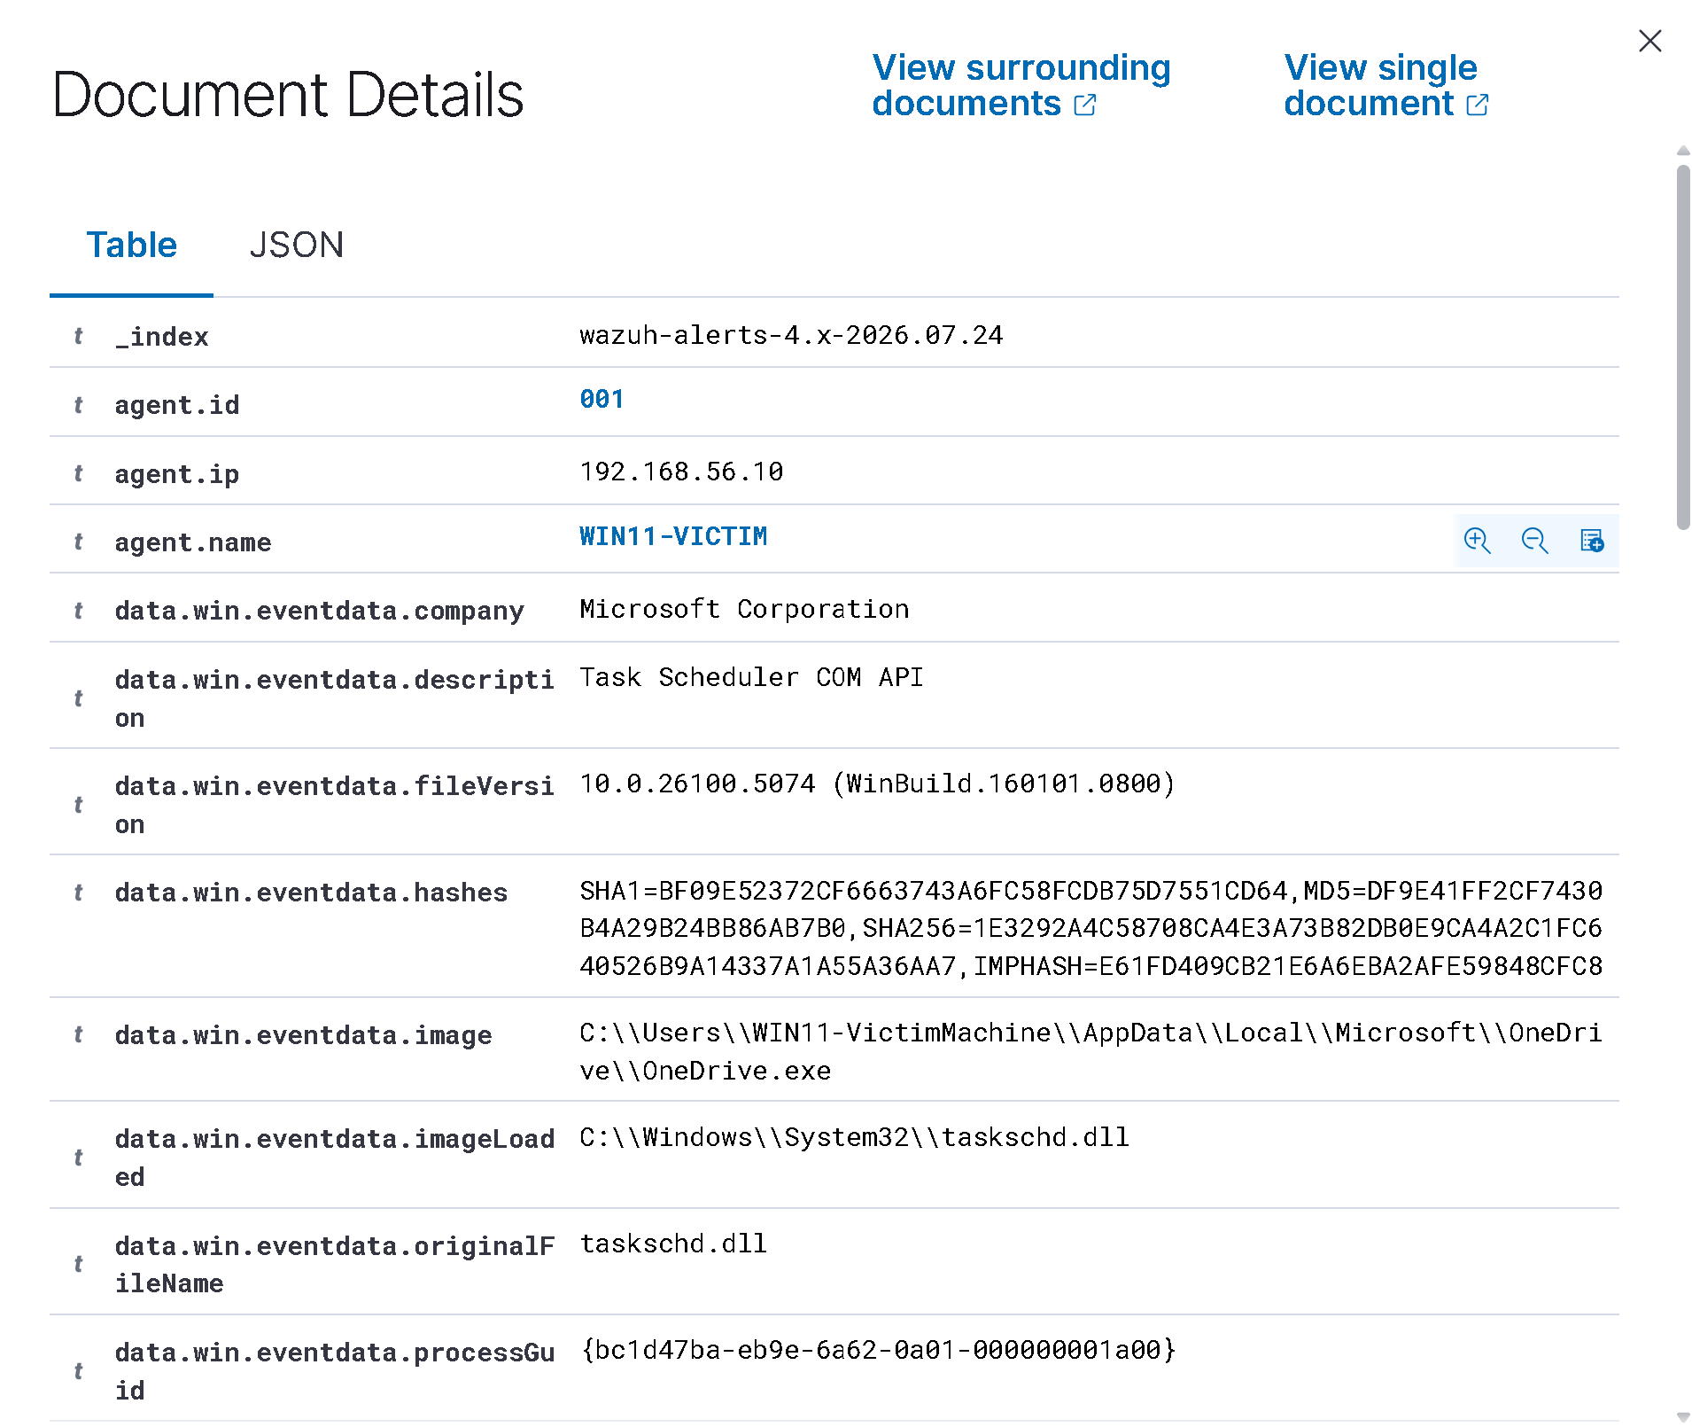
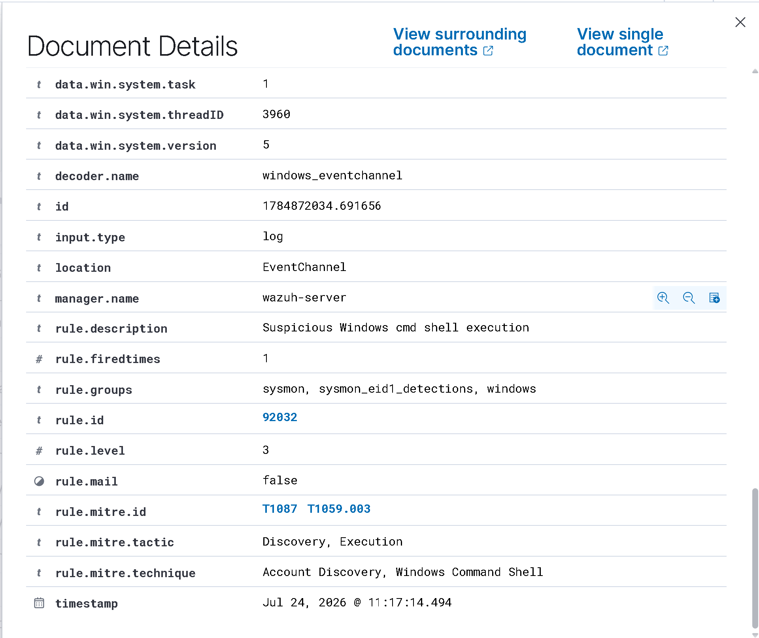
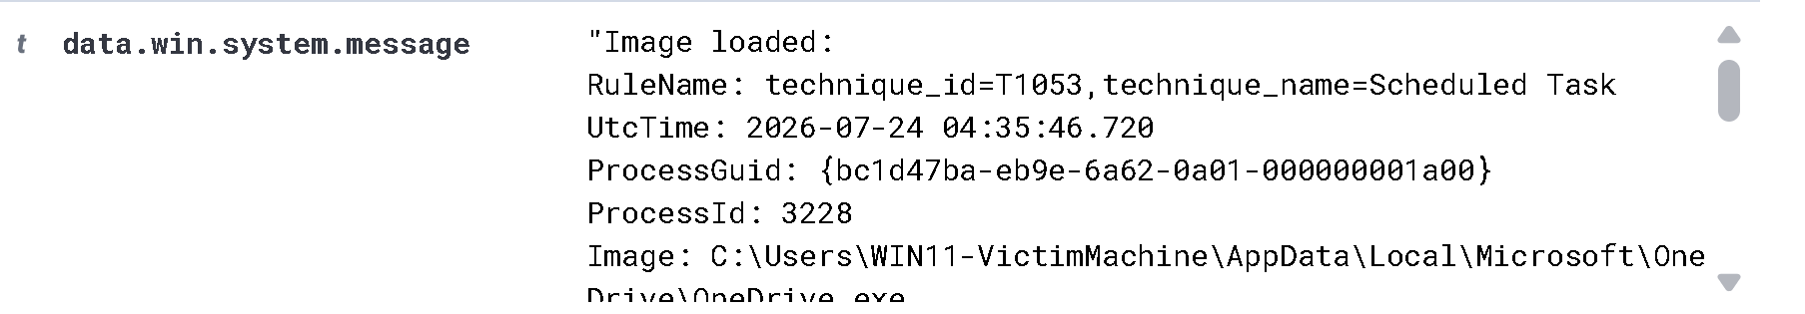

Slide 15
DETECTION ENGINEERING
MITRE ATT&CK-Mapped Detections
Every detection generated in this SOC project is mapped to the MITRE ATT&CK framework. Attack traffic from Kali Linux is detected by Sophos Firewall, analyzed by Wazuh SIEM, and enriched using MISP Threat Intelligence.
T1059.001
T0146
T1071
Reconnaissance
Discovery
Command & Control
Active Scanning , Nmap Host Discovery
Port Scanning , Service Enumeration
Http & Https Communication Monitoring
Threat Intelligence
Endpoint Monitoring
SIEM Correlation
MISP Enrichment
Windows Sysmon
Wazuh Detection
IOC Lookup, IP Reputation , Domain Reputation
File Creation , Process Creation , Network Connection
Log Correlation, Alert Generation ,MITRE Mapping
Threat Intelligence Driven SOC
7

Slide 16
IMPLEMENTATION
Phase 1 & 2 — Environment and Endpoint Setup
PHASE 1 — ENVIRONMENT SETUP
PHASE 2 — ENDPOINT TELEMETRY
Created an isolated host-only virtual network (192.168.56.0/24) with no route to the real LAN.
Provisioned Windows 11, Ubuntu Server, and Kali Linux VMs under VMware Workstation.
Assigned static IP addressing and verified inter-VM reachability before installing any security tooling.
Configured consistent system time and timezone across all VMs for accurate log correlation..
Installed Sysmon on Windows 11 using a baseline configuration tuned for security-relevant event capture.
Enabled Auditd and native syslog on Ubuntu Server for authentication and command-execution auditing.
Deployed the Wazuh agent on both endpoints, registered independently and directly to the Wazuh Manager.
Verified agent status as Active before proceeding — detection cannot be validated on top of a broken telemetry link.
Threat Intelligence Driven SOC
8

Slide 17
DETECTION ENGINEERING
Detection Rule
MITRE ATT&CK: T1059.003 – Windows Command Shell
conditititle: Suspicious Windows CMD Shell Execution
logsource:
product: windows
service: sysmon
detection:
selection:
Image|endswith: '\cmd.exe'
condition: selection
level: medium
tags:
- attack.execution
- attack.t1059.003
Detects any process opening a handle to lsass.exe with memory-read access rights — the mechanism behind credential dumping, regardless of which tool is used.
Deliberately excludes known-good EDR/AV access patterns to reduce false positives.
Validated by triggering Atomic Red Team test T1003.001 and confirming the alert fires within the expected window.
9

Slide 18
IMPLEMENTATION
Phase 3 & 4 — Threat Intel and Attack Simulation
PHASE 3 — MISP INTEGRATION
PHASE 4 — ATTACK SIMULATION
Deployed MISP and configured Threat Intelligence feeds for IOC enrichment.
Generated an API key and integrated Wazuh with MISP using a custom integration script for IOC lookup.
Verified enrichment end-to-end using wazuh-logtest before trusting live alert.
Nmap: Host discovery, port scanning, and service enumeration.
EICAR Test File: Safe endpoint detection and IOC validation.
Windows Sysmon: Process, file creation, and network event collection.
Wazuh: Alert correlation and MISP IOC enrichment.
Threat Intelligence Driven SOC
10

Slide 19
DETECTION & ALERT PIPELINE
End-to-End Detection & Alert Enrichment Pipeline
1
2
3
4
Attacker action executed from Kali
Sysmon / Auditd captures the raw event
Wazuh Agent (TCP 1514) or Sophos Syslog (UDP 5514) forwards the event
Wazuh decoder parses it into fields
5
6
7
8
Rule engine matches a MITRE-mapped rule
Alert generated and indexed
MISP enrichment queried (if IOC-eligible)
Analyst investigates on the dashboard
Threat Intelligence Driven SOC
12

Slide 20
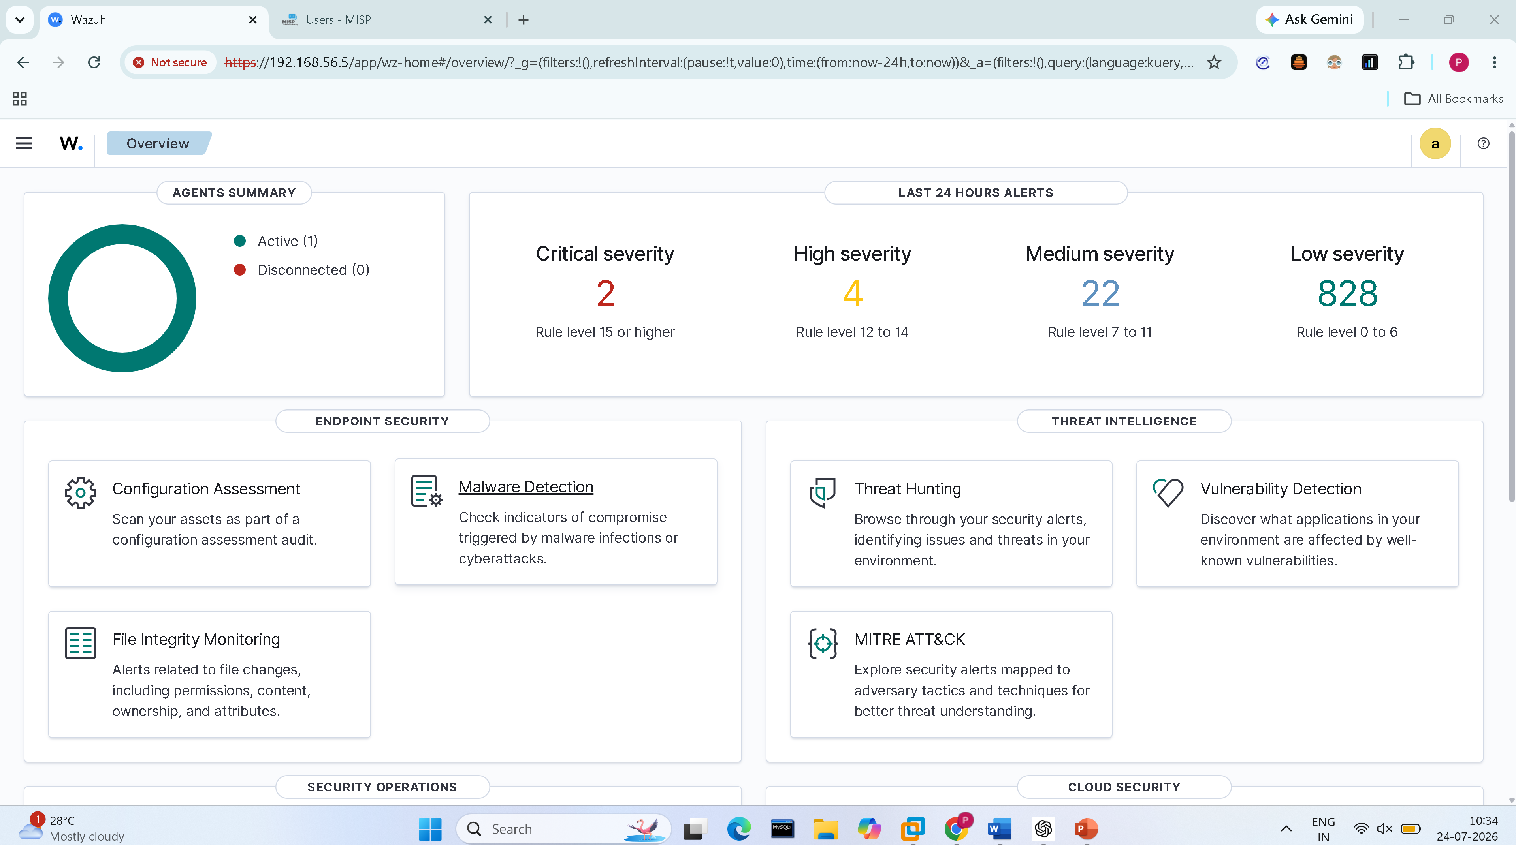
DETECTION & ALERT PIPELINE — EVIDENCE
Wazuh Alert Output
▣
Insert a screenshot of a fired alert here — e.g., the LSASS-access or PowerShell-execution rule from this deck, captured from the Wazuh dashboard's Threat Hunting module.
Threat Intelligence Driven SOC
13

Slide 21
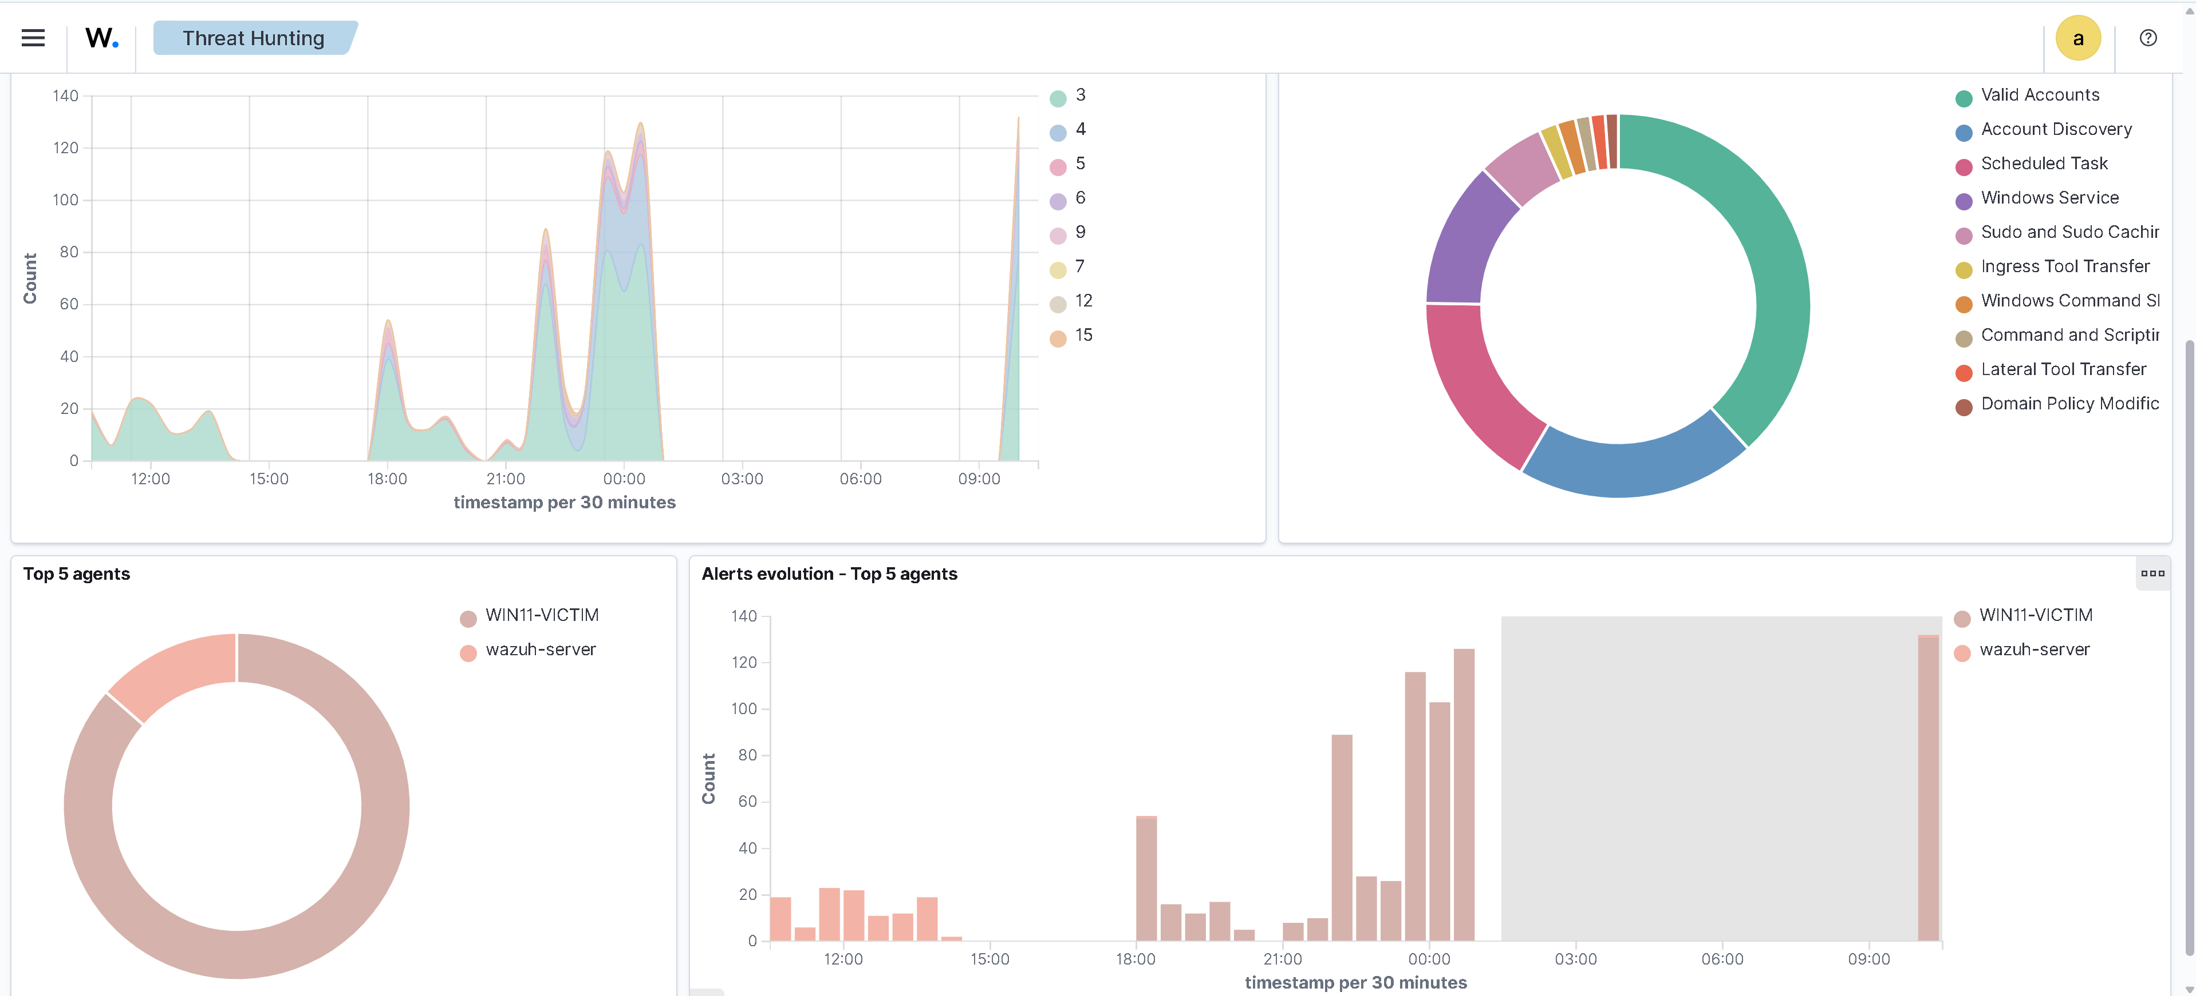
DETECTION & ALERT PIPELINE — EVIDENCE
Wazuh Alert Output
▣
Insert a screenshot of a fired alert here — e.g., the LSASS-access or PowerShell-execution rule from this deck, captured from the Wazuh dashboard's Threat Hunting module.
Threat Intelligence Driven SOC
13

Slide 22
DASHBOARD & ENRICHMENT
Wazuh Dashboard — Visualization and Query, Together
Unlike a separate SIEM + query-language pairing, Wazuh's dashboard combines alert visualization and raw log search (Discover) in one interface — this slide merges what would otherwise be two separate slides.
Security Events
MITRE ATT&CK View
Discover
Real-time alert stream by rule, agent, and severity
Built-in coverage matrix by tactic and technique
Free-text and field-based query across raw logs
Integrity Monitoring
Threat Enrichment Panel
Vulnerabilities
File and registry change tracking
IOC match context attached to eligible alerts
Agent-reported CVE exposure
Threat Intelligence Driven SOC
14

Slide 23
RESULTS & FINDINGS
Project Outcomes
OUTCOMES
KEY FINDINGS
✓
Deployed a Wazuh SIEM with Sysmon (Windows) and Audited (Ubuntu) telemetry from multiple endpoints.
Correlating endpoint telemetry with threat intelligence significantly improved alert context.
Centralized log collection simplified security monitoring and investigation.
MITRE ATT&CK mapping helped organize detections using a standardized framework
✓
Implemented MITRE ATT&CK-mapped detections for reconnaissance and network service discovery.
✓
IIntegrated MISP for automated IOC enrichment against live threat feeds.
✓
Validated detections using controlled attack simulations (Nmap and EICAR).
Threat Intelligence Driven SOC
15

Slide 24
LEARNING OUTCOMES
What This Project Taught Me
SIEM deployment, log decoder authoring, and rule engineering end to end.
Mapping detections to MITRE ATT&CK techniques rather than writing generic alerts.
★
★
Threat intelligence integration and IOC-based enrichment workflows.
Adversarial simulation as a validation method, not just a demo.
★
★
Structured incident investigation — process tree, timeline, root cause.
Systematic self-review: finding and fixing a real dependency bug in my own detection rules before relying on them.
★
★
Threat Intelligence Driven SOC
16

Slide 25
FUTURE WORK
Planned Enhancements
PRIORITY: SOPHOS INTEGRATION
Further enhance the existing Sophos–Wazuh integration by adding custom decoders, firewall-specific correlation rules, and broader MITRE ATT&CK coverage
Active Directory security — Kerberos attack paths, BloodHound
SOAR-style automation of the investigation checklist
Cloud SOC extension (AWS/Azure log sources)
Malware analysis basics on captured samples
Threat Intelligence Driven SOC
17

Slide 26
Thank You
Questions & Discussion
Pari Tenguriya • B.Tech Cyber Security
Industrial Training — Rise Tech Software Pvt. Ltd., Jaipur

